Slide 1
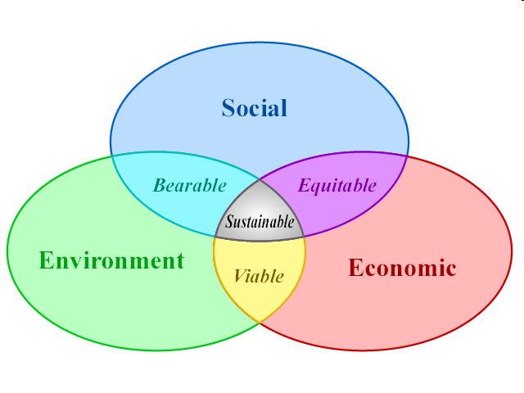
Sustainable Development
Sustainable development is a pattern of resource use that aims to meet human needs while preserving the environment so that these needs can be met not only in the present, but in the indefinite future.
Source: http://en.wikipedia.org/wiki/Sustainable_development

Slide 2
Definition of Sustainable Development
“Development that meets the needs of the present without compromising the ability of future generations to meet their own needs” (Brundtland Commission)*
Development: is the process of change. There are three types of development we will study in this course:
Physical Development
Human Development
Social Development
United Nations. 1987."Report of the World Commission on Environment and Development." General Assembly Resolution 42/187, 11 December 1987. Retrieved: 2007-04-12
Gro Harlem Brundtland (pronounced [ɡru: hɑ:ɭɛm brʉntlɑn:]) (born Gro Harlem, 20 April, 1939) is a Norwegian politician, diplomat, and physician, and an international leader in sustainable development and public health. She is a former Prime Minister of Norway, and has served as the Director General of the World Health Organization (WHO).

Slide 3
Brundtland Commission on “Sustainable Development”
The Brundtland Commission, formally the World Commission on Environment and Development (WCED), known by the name of its Chair Gro Harlem Brundtland, was convened by the United Nations in 1983.
The commission was created to address growing concern "about the accelerating deterioration of the human environment and natural resources and the consequences of that deterioration for economic and social development."
In establishing the commission, the UN General Assembly recognized that environmental problems were global in nature and determined that it was in the common interest of all nations to establish policies for sustainable development.

Slide 4
Resolution establishing the Commission
The 1983 General Assembly (UN) passed Resolution 38/161; "Process of preparation of the Environmental Perspective to the Year 2000 and Beyond" establishing the Commission. In A/RES/38/161, the General Assembly:
"8. Suggests that the Special Commission, when established, should focus mainly on the following terms of reference for its work:
(a) To propose long-term environmental strategies for achieving sustainable development to the year 2000 and beyond;
(b) To recommend ways in which concern for the environment may be translated into greater co-operation among developing countries and between countries at different stages of economic and social development and lead to the achievement of common and mutually supportive objectives which take account of the interrelationships between people, resources, environment and development;

Slide 5
(c) To consider ways and means by which the international community can deal more effectively with environmental concerns, in the light of the other recommendations in its report;
(d) To help to define shared perceptions of long-term environmental issues and of the appropriate efforts needed to deal successfully with the problems of protecting and enhancing the environment, a long-term agenda for action during the coming decades, and aspirational goals for the world community, taking into account the relevant resolutions of the session of a special character of the Governing Council in 1982;“

Slide 6
RIO DECLARATION ON ENVIRONMENT AND DEVELOPMENT (Agenda 21) (Rio de Janeiro, 3-14 June 1992)
With the goal of establishing a new and equitable global partnership through the creation of new levels of cooperation among States, key sectors of societies and people;
Working towards international agreements which respect the interests of all and protect the integrity of the global environmental and developmental system,
Recognizing the integral and interdependent nature of the Earth, our home, Rio Declaration Proclaims 27 principles.

Slide 7
Principles of Agenda 21
Principle 1: Human beings are at the centre of concerns for sustainable development. They are entitled to a healthy and productive life in harmony with nature.
Principle 2: States have, in accordance with the Charter of the United Nations and the principles of international law,
the sovereign right to exploit their own resources
pursuant to their own environmental and developmental policies
And the responsibility to ensure that activities within their jurisdiction or control do not cause damage to the environment of other States or of areas beyond the limits of national jurisdiction.

Slide 8
Principle 3: The right to development must be fulfilled so as to equitably meet developmental and environmental needs of present and future generations.
Principle 4: In order to achieve sustainable development, environmental protection shall constitute an integral part of the development process and cannot be considered in isolation from it.
Principle 5 All States and all people shall cooperate in the essential task of eradicating poverty as an indispensable requirement for sustainable development, in order to decrease the disparities in standards of living and better meet the needs of the majority of the people of the world.

Slide 9
Principle 6: The special situation and needs of developing countries, particularly the least developed and those most environmentally vulnerable, shall be given special priority. International actions in the field of environment and development should also address the interests and needs of all countries.
Principle 7: States shall cooperate in a spirit of global partnership to conserve, protect and restore the health and integrity of the Earth's ecosystem. In view of the different contributions to global environmental degradation, States have common but differentiated responsibilities. The developed countries acknowledge the responsibility that they bear in the international pursuit of sustainable development in view of the pressures their societies place on the global environment and of the technologies and financial resources they command.

Slide 10
Principle 8: To achieve sustainable development and a higher quality of life for all people, States should reduce and eliminate unsustainable patterns of production and consumption and promote appropriate demographic policies.
Principle 9: States should cooperate to strengthen endogenous capacity-building for sustainable development by improving scientific understanding through exchanges of scientific and technological knowledge, and by enhancing the development, adaptation, diffusion and transfer of technologies, including new and innovative technologies.

Slide 11
Principle 10: Environmental issues are best handled with the participation of all concerned citizens, at the relevant level. At the national level, each individual shall have appropriate access to information concerning the environment that is held by public authorities, including information on hazardous materials and activities in their communities, and the opportunity to participate in decision-making processes. States shall facilitate and encourage public awareness and participation by making information widely available. Effective access to judicial and administrative proceedings, including redress and remedy, shall be provided.

Slide 12
Principle 11: States shall enact effective environmental legislation. Environmental standards, management objectives and priorities should reflect the environmental and developmental context to which they apply. Standards applied by some countries may be inappropriate and of unwarranted economic and social cost to other countries, in particular developing countries.

Slide 13
Principle 12: States should cooperate to promote a supportive and open international economic system that would lead to economic growth and sustainable development in all countries, to better address the problems of environmental degradation. Trade policy measures for environmental purposes should not constitute a means of arbitrary or unjustifiable discrimination or a disguised restriction on international trade. Unilateral actions to deal with environmental challenges outside the jurisdiction of the importing country should be avoided. Environmental measures addressing transboundary or global environmental problems should, as far as possible, be based on an international consensus.

Slide 14
Principle 13: States shall develop national law regarding liability and compensation for the victims of pollution and other environmental damage. States shall also cooperate in an expeditious and more determined manner to develop further international law regarding liability and compensation for adverse effects of environmental damage caused by activities within their jurisdiction or control to areas beyond their jurisdiction.
Principle 14: States should effectively cooperate to discourage or prevent the relocation and transfer to other States of any activities and substances that cause severe environmental degradation or are found to be harmful to human health.

Slide 15
Principle 15: In order to protect the environment, the precautionary approach shall be widely applied by States according to their capabilities. Where there are threats of serious or irreversible damage, lack of full scientific certainty shall not be used as a reason for postponing cost-effective measures to prevent environmental degradation.
Principle 16: National authorities should endeavor to promote the internalization of environmental costs and the use of economic instruments, taking into account the approach that the polluter should, in principle, bear the cost of pollution, with due regard to the public interest and without distorting international trade and investment.

Slide 16
Principle 17: Environmental impact assessment, as a national instrument, shall be undertaken for proposed activities that are likely to have a significant adverse impact on the environment and are subject to a decision of a competent national authority.
Principle 18: States shall immediately notify other States of any natural disasters or other emergencies that are likely to produce sudden harmful effects on the environment of those States. Every effort shall be made by the international community to help States so afflicted.

Slide 17
Principle 19: States shall provide prior and timely notification and relevant information to potentially affected States on activities that may have a significant adverse transboundary environmental effect and shall consult with those States at an early stage and in good faith.
Principle 20: Women have a vital role in environmental management and development. Their full participation is therefore essential to achieve sustainable development.
Principle 21: The creativity, ideals and courage of the youth of the world should be mobilized to forge a global partnership in order to achieve sustainable development and ensure a better future for all.

Slide 18
Principle 22: Indigenous people and their communities and other local communities have a vital role in environmental management and development because of their knowledge and traditional practices. States should recognize and duly support their identity, culture and interests and enable their effective participation in the achievement of sustainable development.
Principle 23: The environment and natural resources of people under oppression, domination and occupation shall be protected.
Principle 24: Warfare is inherently destructive of sustainable development. States shall therefore respect international law providing protection for the environment in times of armed conflict and cooperate in its further development, as necessary.

Slide 19
Principle 25: Peace, development and environmental protection are interdependent and indivisible.
Principle 26: States shall resolve all their environmental disputes peacefully and by appropriate means in accordance with the Charter of the United Nations.
Principle 27: States and people shall cooperate in good faith and in a spirit of partnership in the fulfillment of the principles embodied in this Declaration and in the further development of international law in the field of sustainable development.

